Slide 1

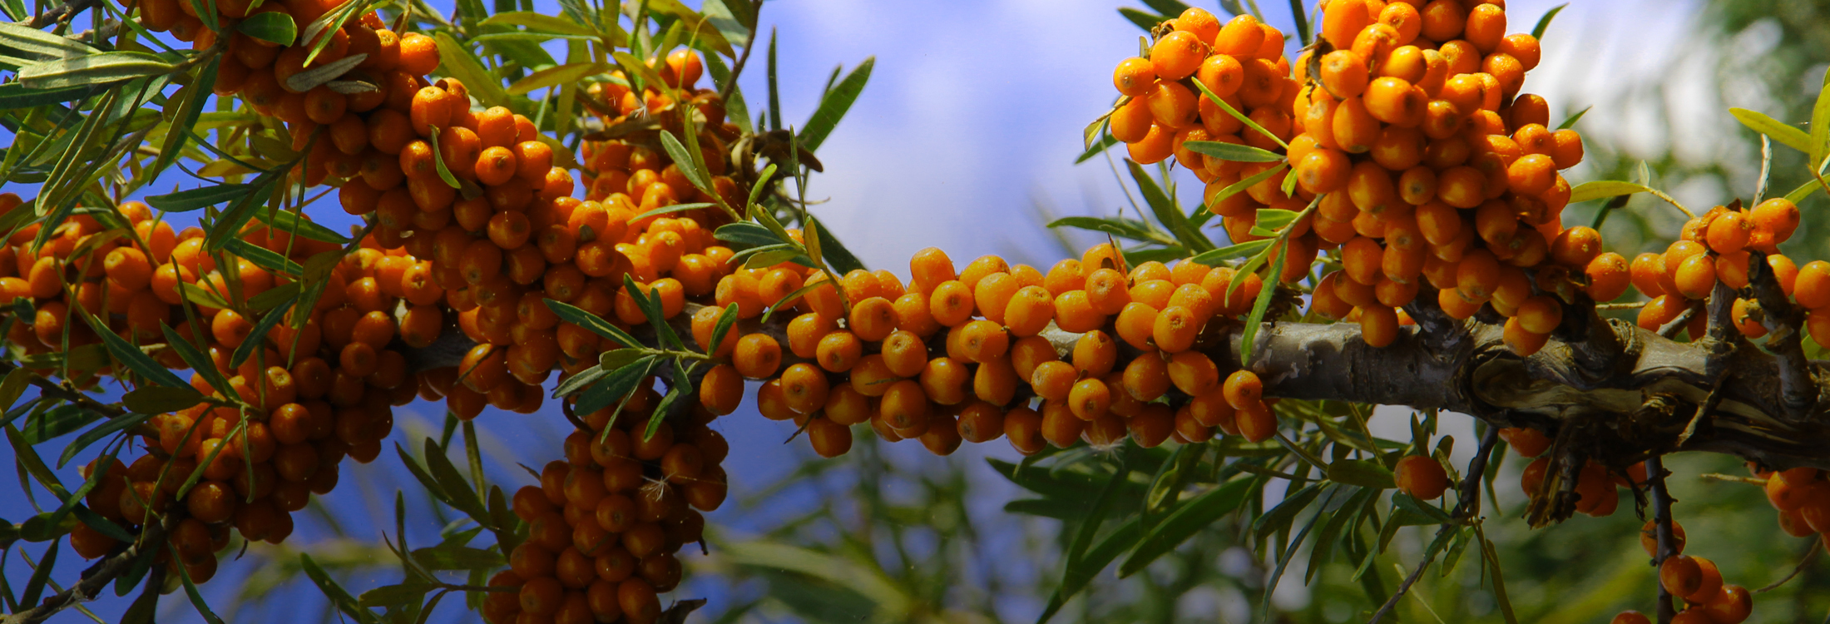
BIO CATINA COOPERATIVA AGRICOLA
ROMANIAN SEA BUCKTHORN PLANTATIONS ECOLOGICAL CERTIFIED

Slide 2
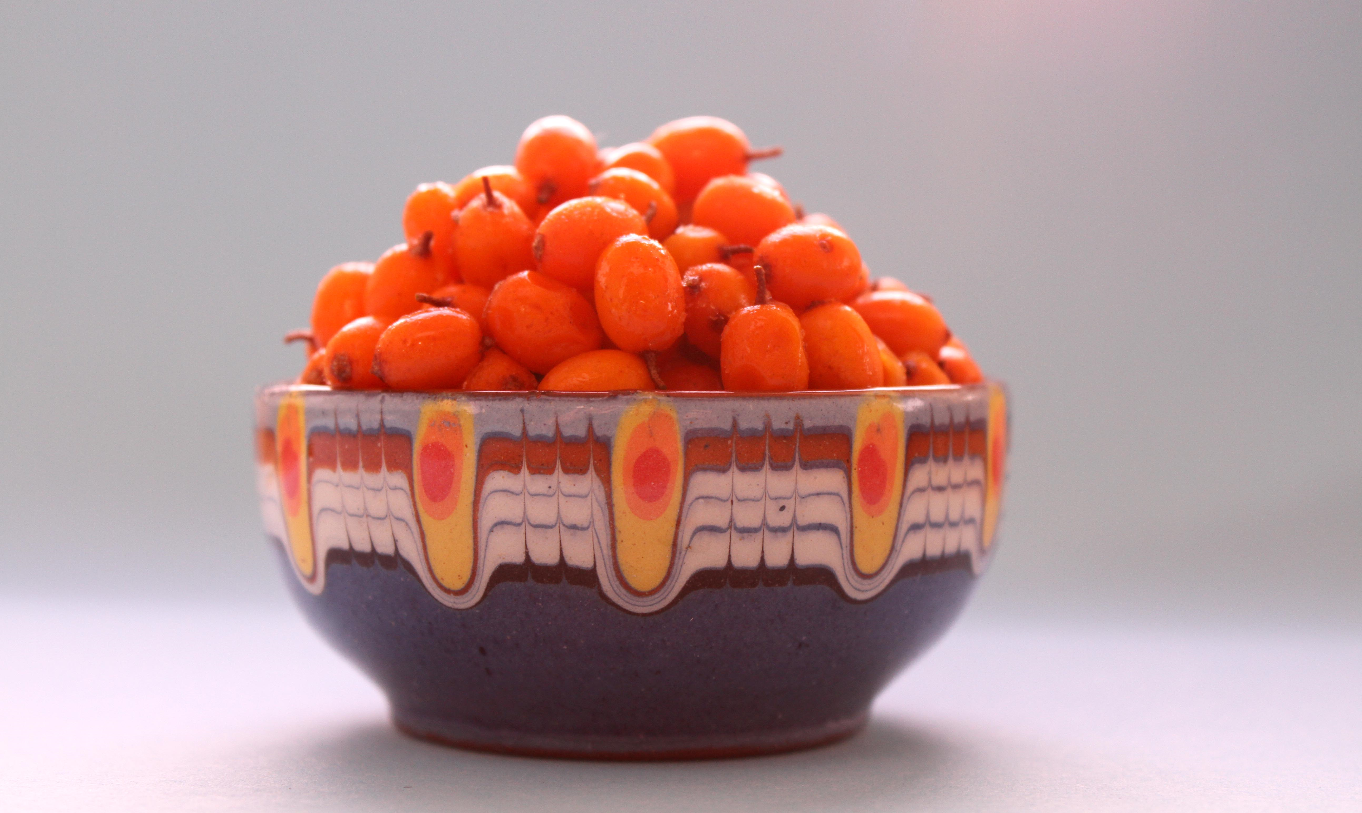

The Plant (Sea buckthorn berry - Hippophae rhamnoides L)
The sea buckthorn berry is a super fruit full of all the Omegas: 3-6-9 and the rare Omega-7, as well as a host of antioxidants and other healing nutrients. It has been used to heal psoriasis and make skin glow, boost immunity, slow aging, and lower cholesterol, but it also has numerous other qualities that make it a superior source of vitamins and minerals we all need.
In the ripe sea buckthorn fruits the vitamin C content is 400-800 mg per 100 g fresh fruit. Other vitamins, such as: A, B1 , B2 , B6, B9 , E, K , P, F; also the cellulose, beta-carotene (a rate much higher than in carrot pulp) zinc, fier, manganese, trace elements of phosphorus, calcium, potassium, sodium, complex oils, as well as the carotenoids, xanthophylls, phenolics, flavonoids, make this fruit an absolute powerhouse of nutrients!
The leaves, berries and roots can all be used in different forms.
It is a complete food that can support the human body in many ways:
  Slows the aging process
  Reduces illness associated with cancer
  Lowers cholesterol
  Contributes to proper brain and nervous system functioning
  Increases the libido and potency
  Treats gastrointestinal disorders including ulcers
  Promotes colon health
  Eliminates skin rashes
  Cures infections
      Boosts lymphatic circulation and immunity
      Reduces inflammatory response in the body
      Improves mental clarity
      Treats asthmatic symptoms
      Reduces appetite
      Improves the look of skin & hair
      Neutralizes free radicals in the body
      Supports internal organs
      Supports urogenital system
      Reduces the condition of a fatty liver
      Helps to increase cellular vitality
      Improves sight, lessens eye soreness

Slide 3
The Plant (Sea buckthorn berry – Hippophae rhamnoides L)
Nutrition and Health claims
Properties:
    Zinc 179% NRV Contributes to the normal functioning of: the immune system / acid-base metabolism / metabolism of carbohydrates / cognitive function / DNA synthesis / fertility and reproduction / metabolism of fatty acids / metabolism of vitamine A / protein synthesis; it also maintains the health of the bone system / normal vision and testosterone levels in the blood, hair, nail as well as skin health and helping protect cells against oxidative stress…;
    Iron 196% NRV Contributes to the cell division process, to normal: cognitive function / energy metabolism / formation of red blood cells and hemoglobin / oxygen transport in the body / functioning of the immune system, also to reducing fatigue and exhaustion;
    Manganese 593% NRV Contributes to normal: energy metabolism / formation of connective tissues; helps protect cells against oxidative stress, helps maintain the health of the bone system;
    Vitamine C Helps maintain the normal functioning of the immune system during intense exercise and afterwards, helps protect cells against oxidative stress and reduce fatigue and exhaustion, increases the absorption of iron with a beneficial effect in case of anemia, contributes to normal formation of the collagen for the good functioning of blood vessels, of the bone system, of the ligaments, the gums, the skin; contributes to normal energy metabolism / functioning of the nervous system; maintains the mental health and the normal functioning of the immune system;
    Vitamine D Helps maintain the normal calcium levels in the blood, the dental health, the health of the bone system, contributes to the normal absorption / use of calcium and phosphorus; to maintaining the normal function of the muscular system and participates in the cell division process;
    Vitamine A Helps maintain the health of mucous membranes, of the skin / the normal vision and functioning of the immune system and contributes to the cell differentiation process;
    Vitamine K Helps maintain the normal blood clotting and the health of the bone system;
    Vitamine E Helps protect cells against oxidative stress.

Slide 4
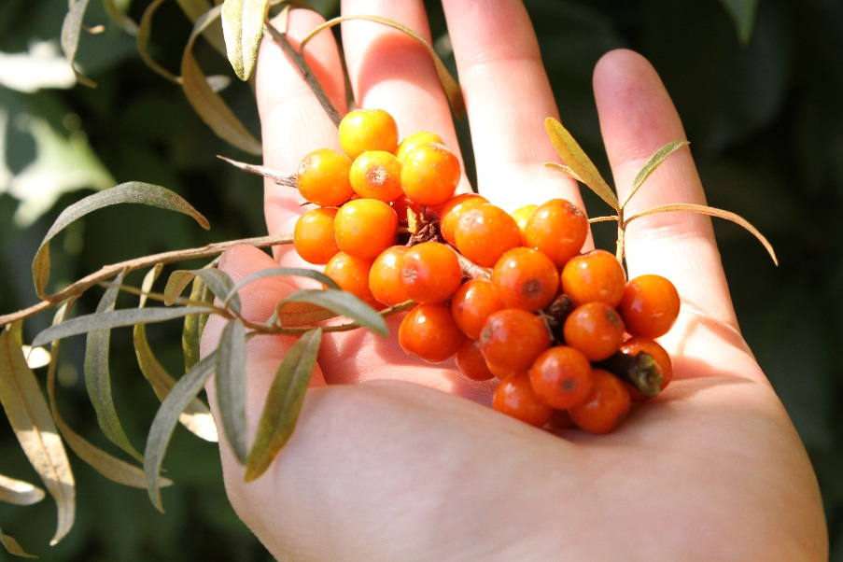
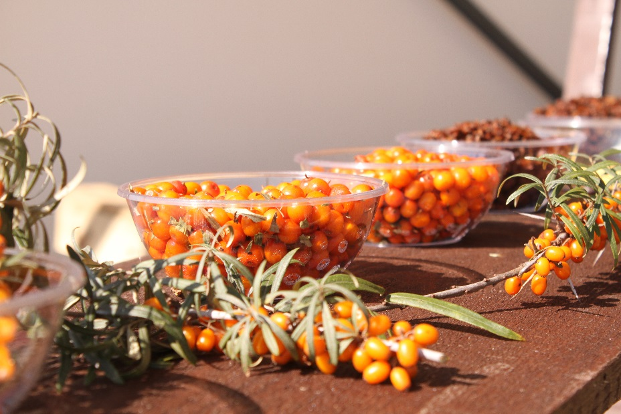
The Plant (Sea buckthorn berry – Hippophae rhamnoides L)
Nutrition and Health claims
Properties (continued):
    Food with low saturated fatty acids - Reducing the consumption of saturated fat contributes to maintaining normal blood cholesterol levels;
    Oleic acid, an unsaturated fat - Replacing saturated fats from food with unsaturated fat contributes to maintaining normal blood cholesterol levels.

Slide 5
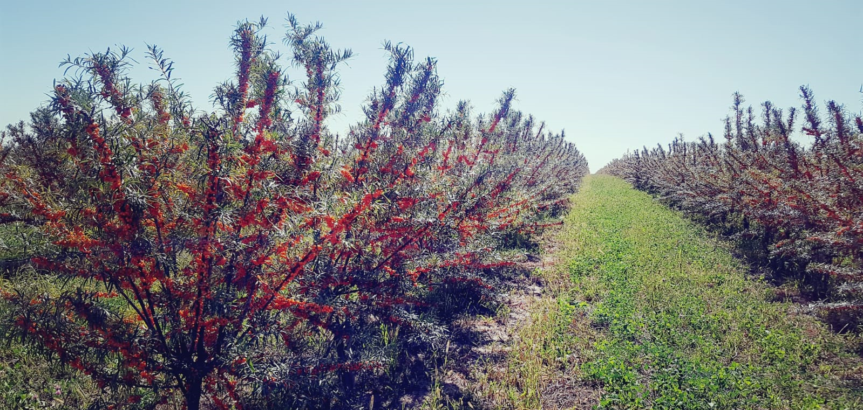
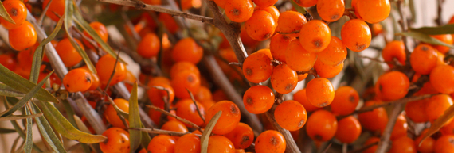
The Plantations
Location
  Bio Catina Cooperativa Agricola cultivates Romanian organic sea buckthorn at the highest quality standards throughout an association of many farms across Romania. The area we cover at this moment is 150 hectares of sea buckthorn plantations. The plantations are scattered along Romania’s landscape providing full climate environmental security.
Ecology and Soil
  The locations were carefully chosen in the fertile floodplain, surrounded by the wild Romanian Carpathians.
  The composition of the soil is of sandy loam type with middle eutricambosoil stalled in the first 50 cm is influenced by the groundwater near the surface and offers exceptional premises for the culture of the sea buckthorn orchard.
  The plantations are ecologically certified and the fruits have outstanding nutritional values.
Harvesting
  The farm has its own equipment for -40ºC fast freezing and storage at -20ºC, used exclusively for the sea buckthorn fruits.
  We use the latest agricultural technology flow that allows harvesting the fruit without the operators actually touching the fruit.
  Freezing method
  The result of using modern technology is measurable: the sea buckthorn berry reaches the freezing chamber at -40ºC within 2 hours from harvest.
  By freezing the fruits at -40º C, the natural processes of decay are stopped. It is an innovative method of harvest that guarantees keeping unaltered the properties of the sea buckthorn fruit.
  The fruit is harvested in August and September, at full maturity. It is then selected, resulting in a homogeneous product of high quality.

Slide 6
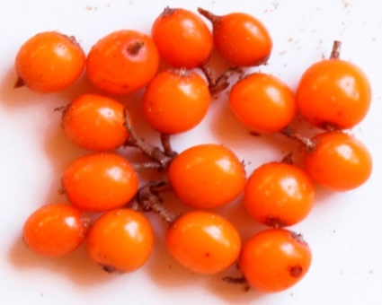
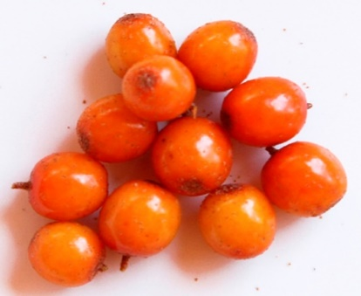
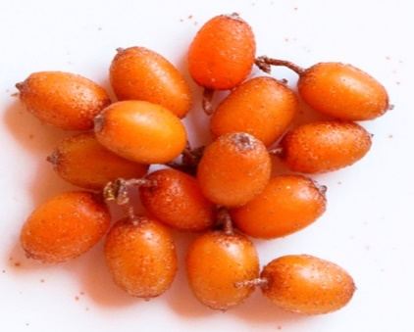
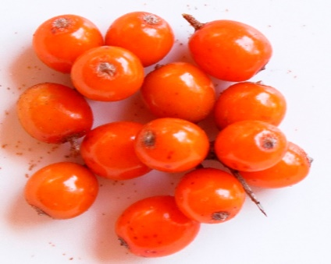
The Product
  The sea buckthorn berry fruit (raw material - frozen, dried or oil) is the main product of Bio Catina farms:
    Each component percent depends on the variety , the time of harvest and climatic conditions of the year;
    Every year we make specific determinations of bioactive compounds from this fruit, for each variety, in international specialised laboratories.
Description of planted Bio Catina sea buckthorn varieties:
    CLARA Early, large fruit , yellow-orange, juicy pulp, thin skin – rich in oils (oil)
    MARA Large fruit, intense yellow-orange – delicate aroma (juice and other products)
    CORA Round fruit, yellow-orange – low in oils (grounded)
    PITESTI2 Very early , mid-sized fruit , round, intense yellow colour – intense aroma (best for juice and other products)
CLARA
MARA
CORA
PITESTI 2

Slide 7
The Eco Certificate (RO & EN)

Slide 8
The Universe BioCatina – the biological sea buckthorn

Slide 9
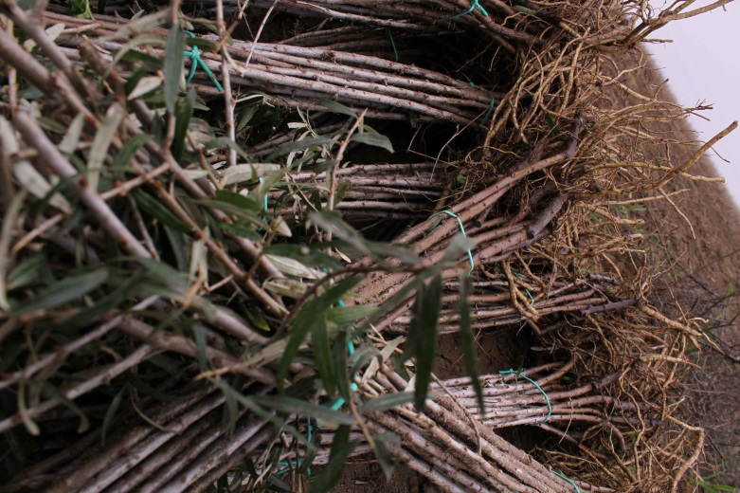
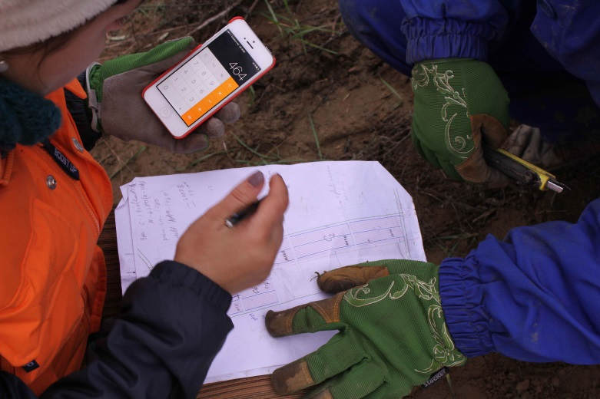
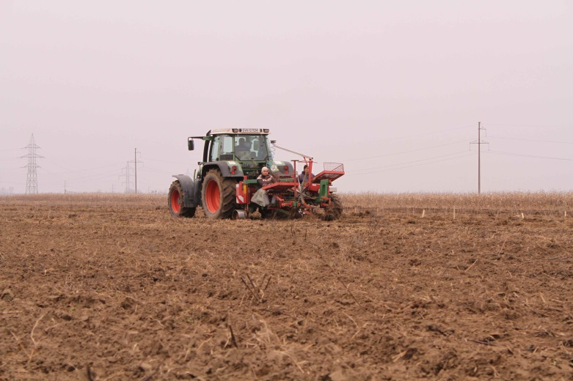
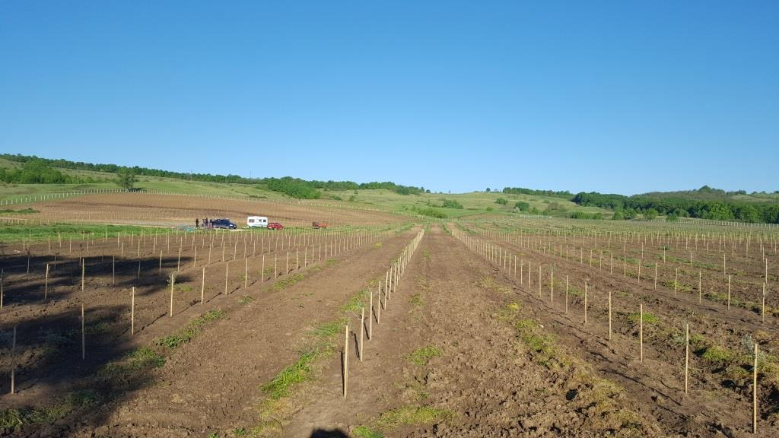
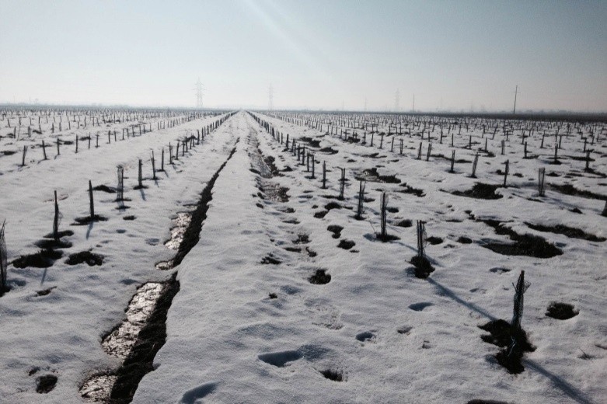
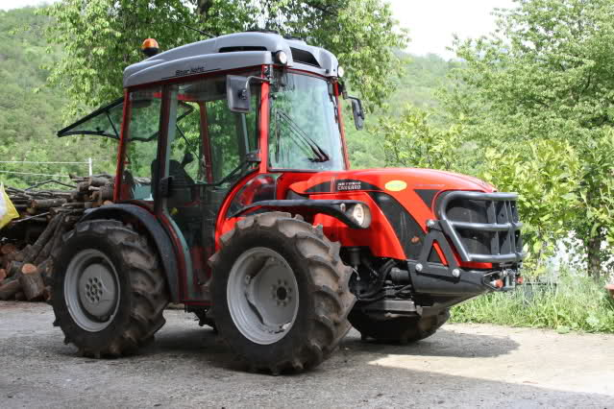
The Beginning...
Certified Seedlings
Comparing the sketches
Mechanized planting using GPS
First spring
First winter
Modern equipment

Slide 10
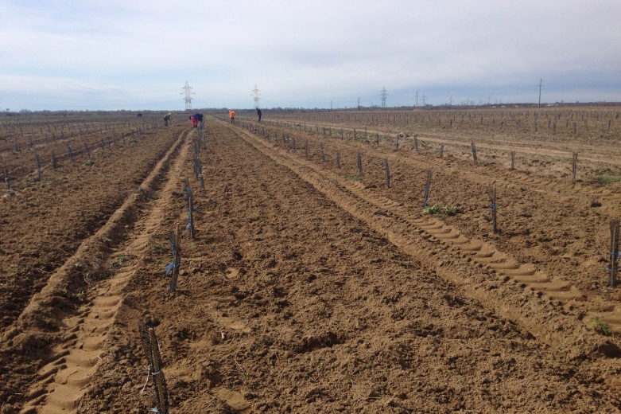
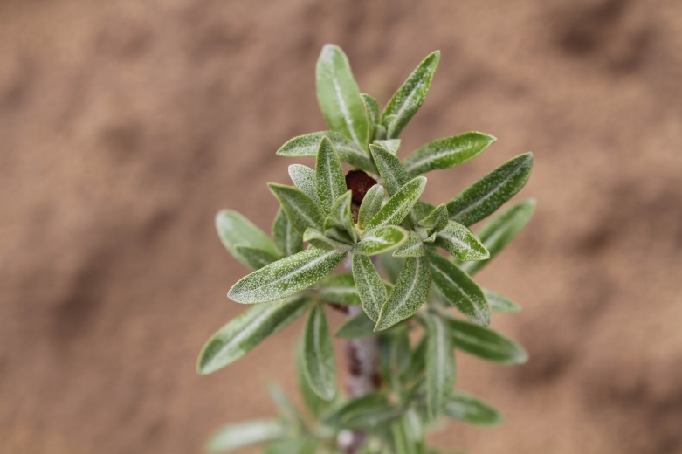
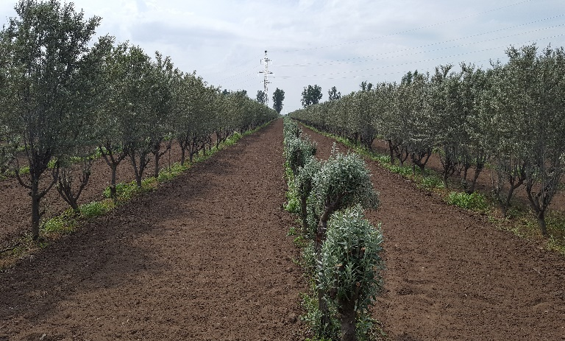
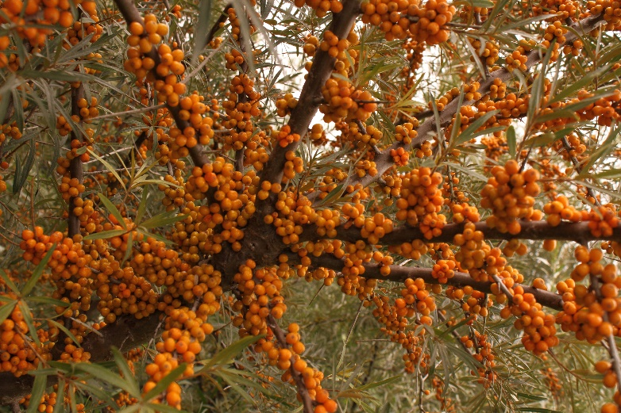
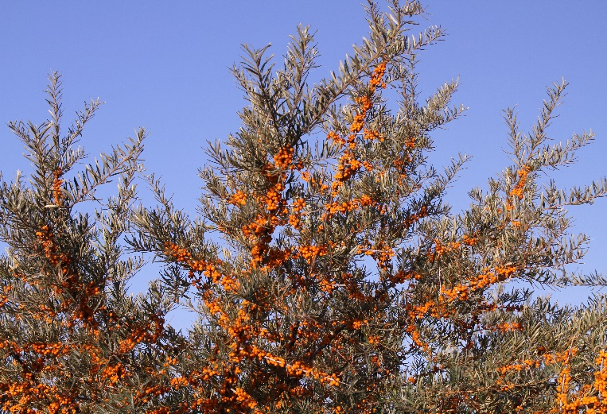
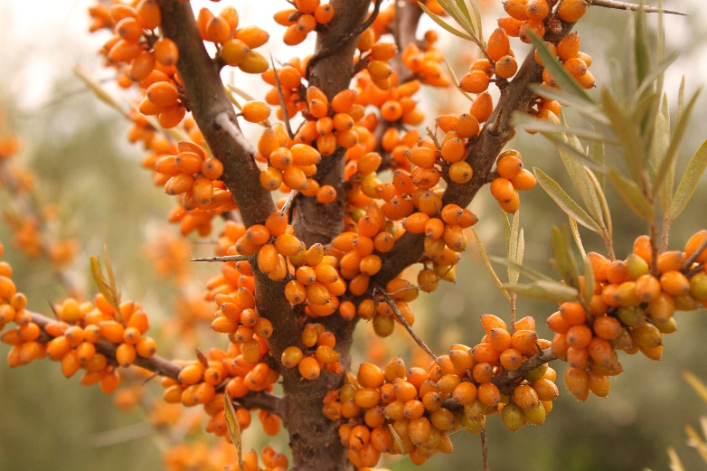
The Maintenance and First Harvest
Maintenance works – spring 2015
First buds
Soil maintenance
Close to Harvest, 2017
Close to Harvest, 2017
Close to Harvest, 2017

Slide 11
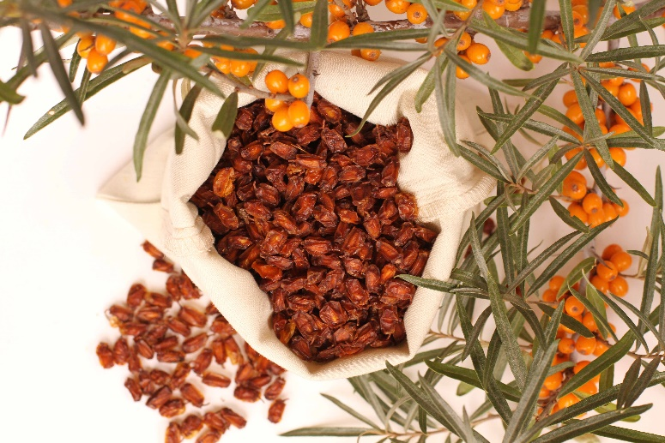
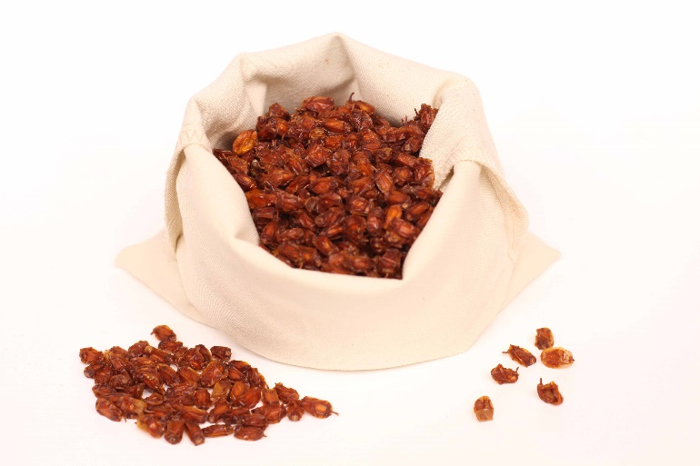
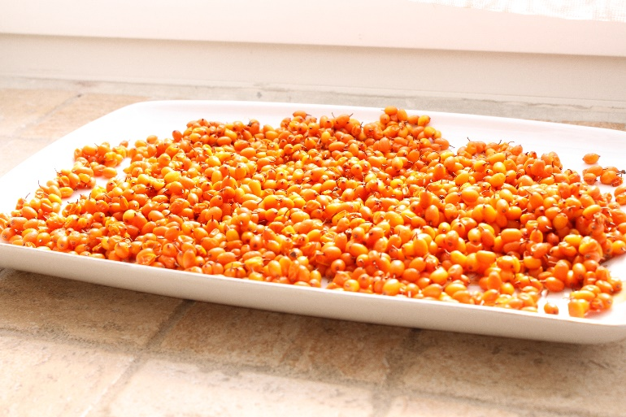
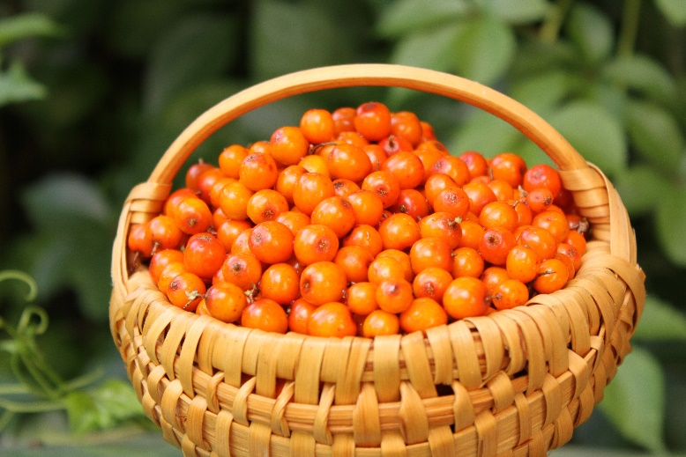
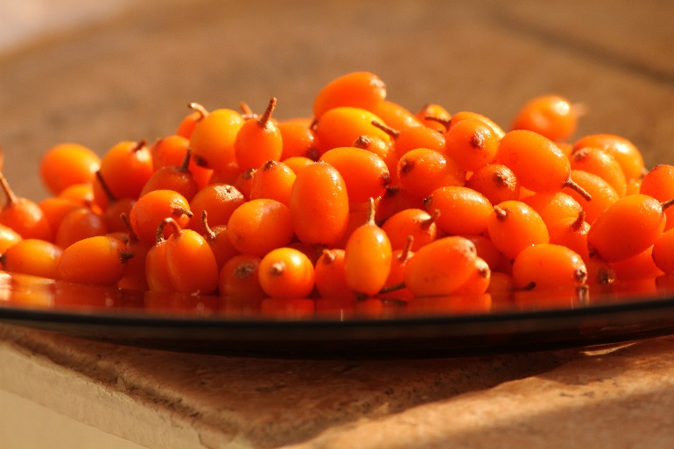
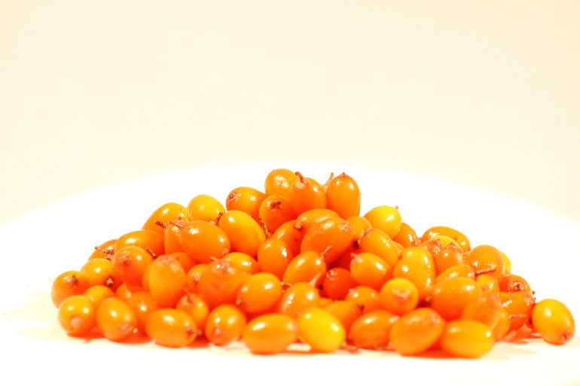
The Sea buckthorn Fruits

Slide 12



The Technology and Equipment for Freezing and Storage
Blast Freezer Technology (freezing at -40ºC and storage at -20ºC)

Slide 13
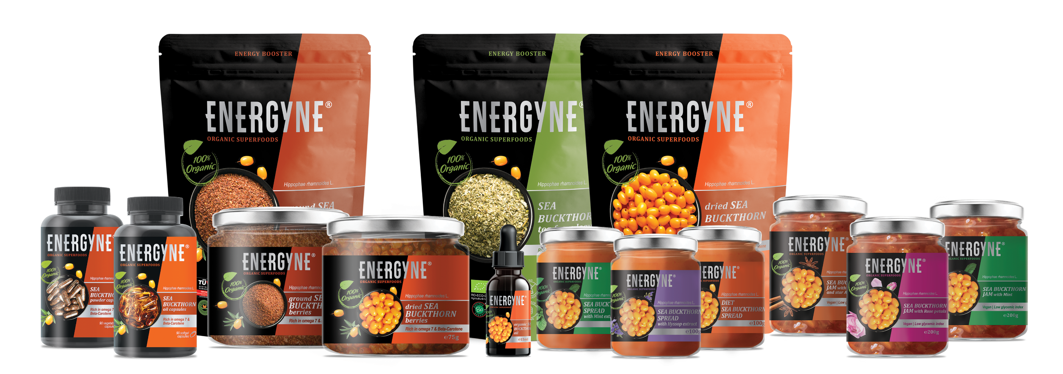
The Processed Bi Catina Products Portfolio

Slide 14




Send us an e-mail, to plan a visit! ☺
BIO CATINA COOPERATIVA AGRICOLA
VAT No: 36569857, Reg. No: C15/7/27.09.2016
office@biocatina.com
www.biocatina.com

Slide 15
Thank you!

